Slide 1
What is your experience with programming?
Place your post it above the appropriate response.

Slide 2
Creating and Innovating in the Algebra Classroom through Computer Programming
Wi-Fi:
NCTM
NCTM2022
Robert Richardson, JHU
richa68@jhu.edu
https://algprogramming.weebly.com/

Slide 3
Creating and Innovating in the Algebra Classroom through Computer Programming (conceptual framework)
One idea for integrating Computer Science/Computational thinking in an Algebra class.
Programming is essentially teaching a computer (kind of like a very skillful small child) how to do something.
And we all know that teaching is a powerful learning experience.
Students will have a product, a tangible artifact, of their learning experience.
This opportunity is rare in traditional secondary mathematics, where we generally work out of textbooks or worksheets.

Slide 4
Why integrate Computer Science
What is the empirical justification?

Slide 5
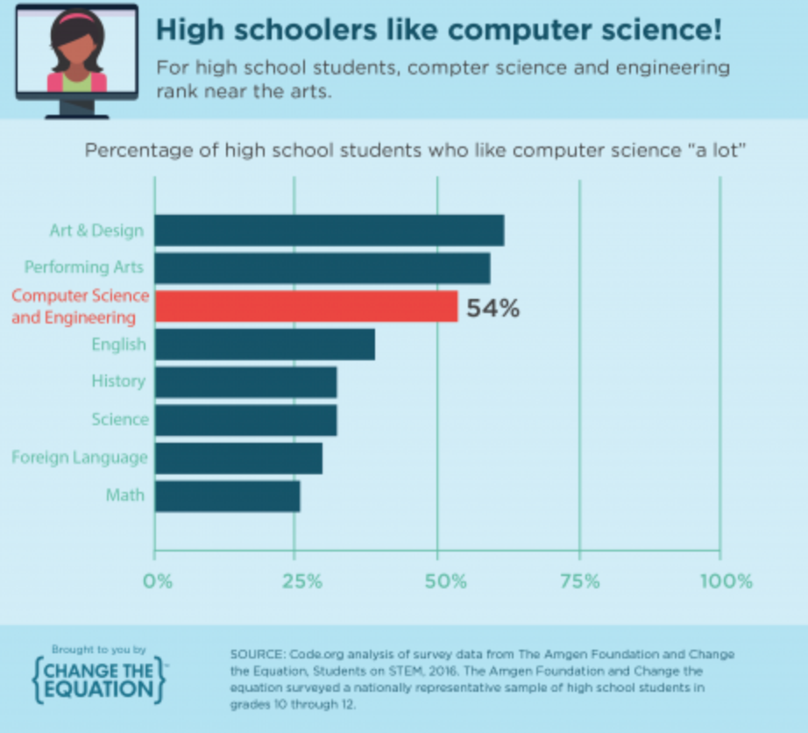
Promoting Joy in the Classroom

Slide 6
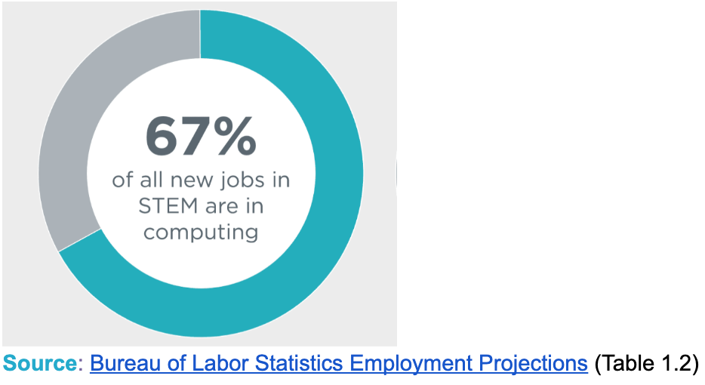
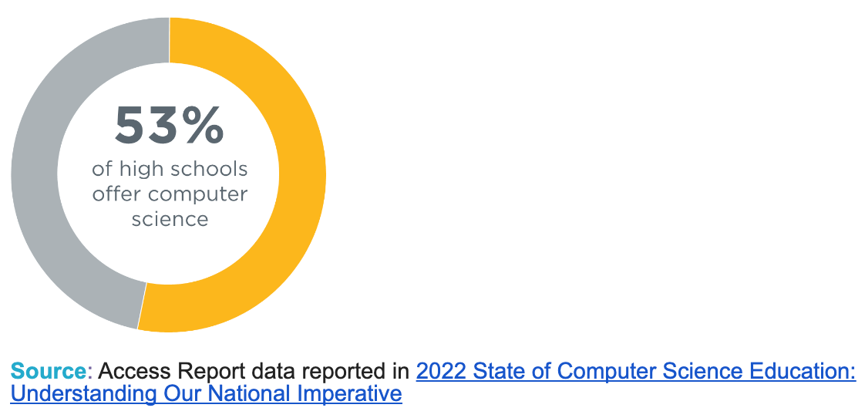
Computational Literacy is Significant (and significantly neglected)
So, there are a lot of students that don't get access or "exposure"!

Slide 7
Opportunity is key
Students who program in high school are 6 times more likely to major in computer science than those who do not.
Black/African American and Hispanic/Latino/Latina students are 7 or 8 times more likely to major in computer science when they program in high school.
Women who try programming in high school are ten times more likely to major in CS in college
Source: Students in College: An Analysis of Five-Year Academic Careers - College Board (2007)

Slide 8
Why integrate computer science in math? Cognitive outcomes
Training in computational thinking has been shown to be transferable to problem-solving across domains (Salehi et al., 2020).
Studies have shown that students who take programming classes perform better on logical reasoning and problem-solving skills (e.g., Tu & Johnson, 1990; Werner et al., 2012).
Asking students to solve problems using an unfamiliar formal system such as a new programming language can help transmit problem-solving skills (Saeli et al., 2011).
Have any of you had positive experiences that echo these statements?
Flexible problem-solving! Adaptability

Slide 9
Challenge to start...
Let’s Race!

Slide 10
Challenge – Algebra Skills Race!
I need the coordinates of two points (with different x-values).

Slide 11
Challenge – Algebra Skills Race
Find the equation of the line between the two points.
Find the distance between the two points.

Slide 12
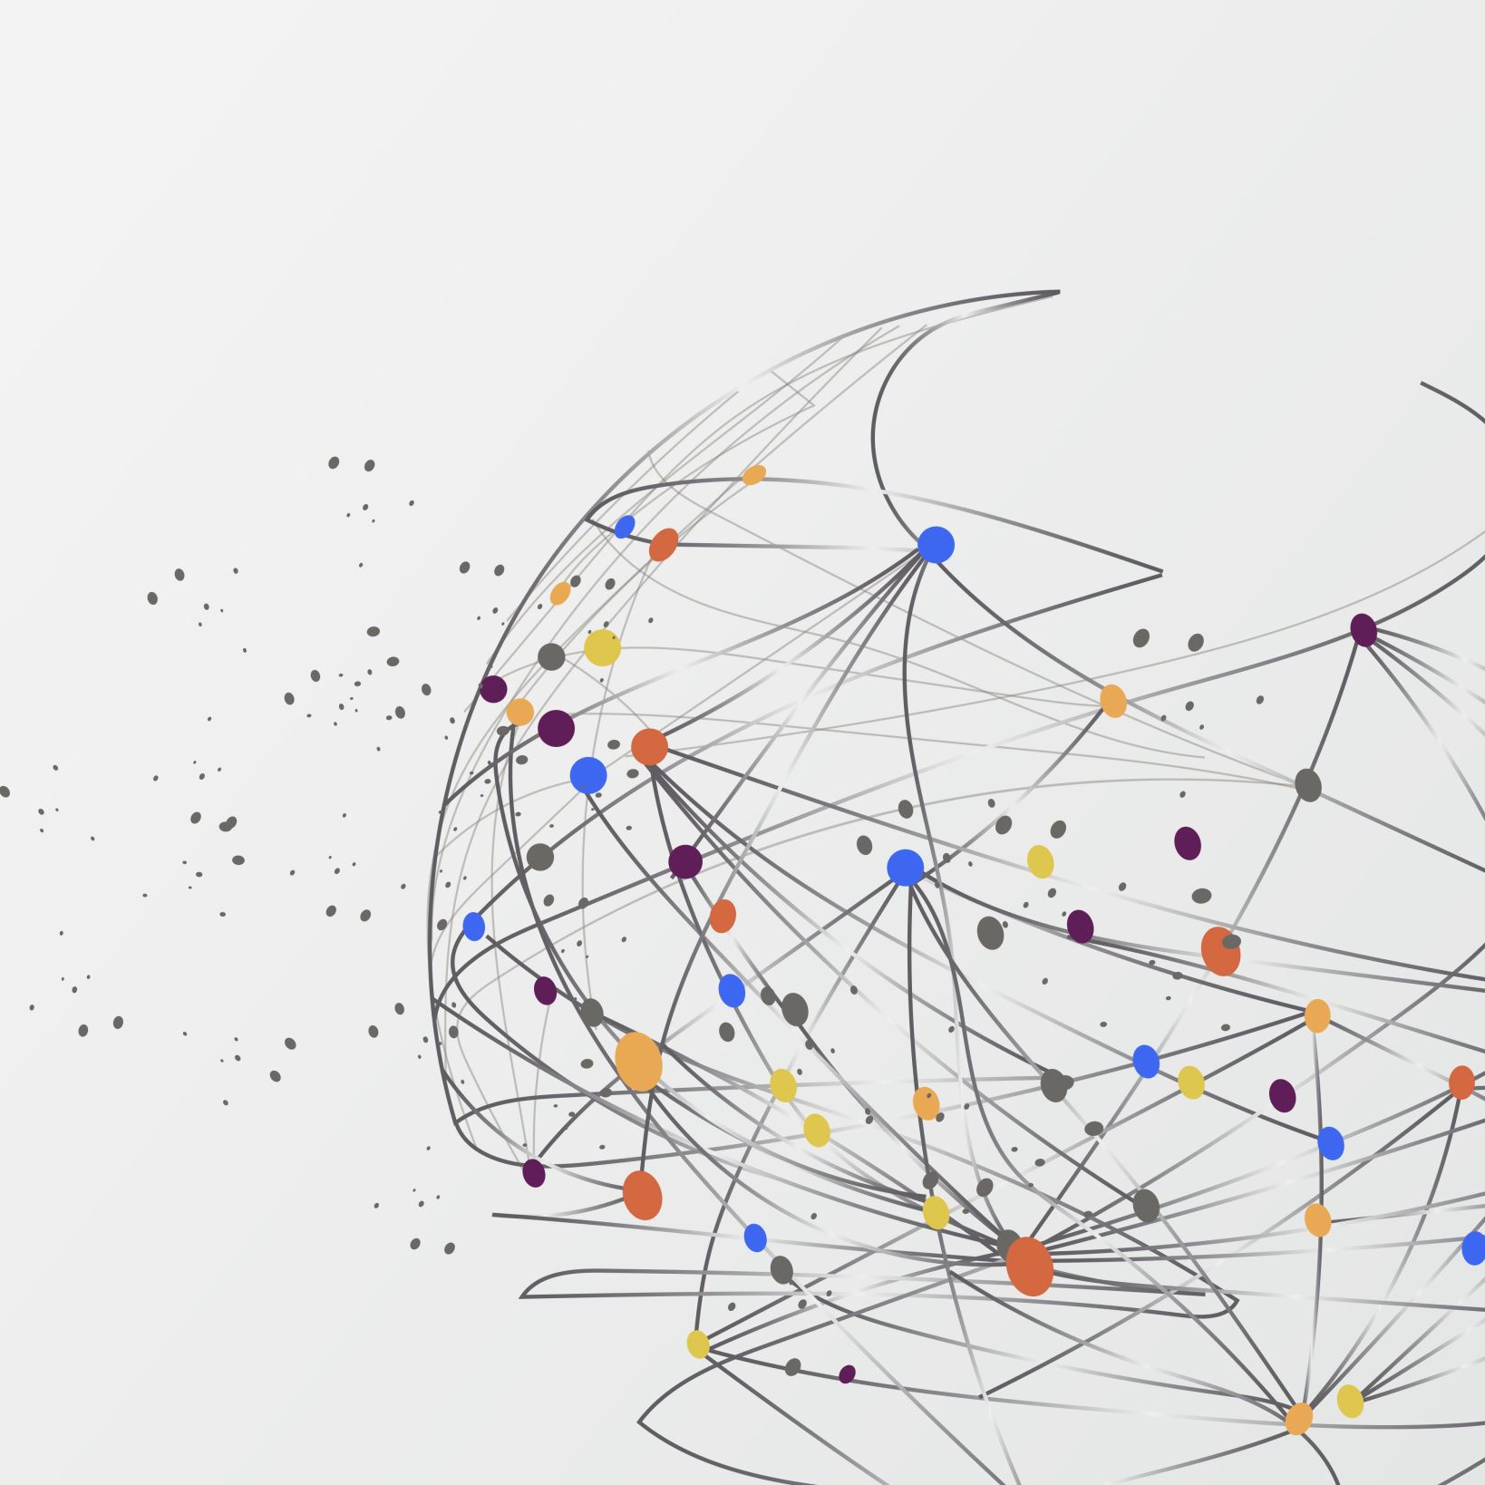
My Web-based Algebra App
How did I get my answer so quickly?
https://codepen.io/rrichardson825/pen/MWVoJme

Slide 13
Find the equation of the line that passes through two points

Slide 14
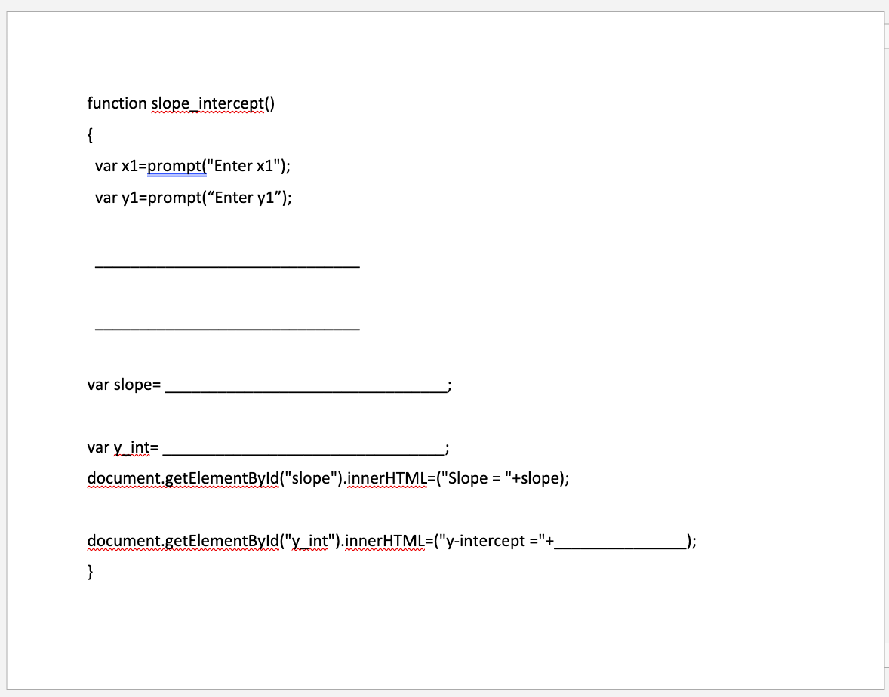
JavaScript for finding the equation of a line
What is missing from this code?
Fill in the missing lines/portions of code to complete the slope_intercept() function.

Slide 15
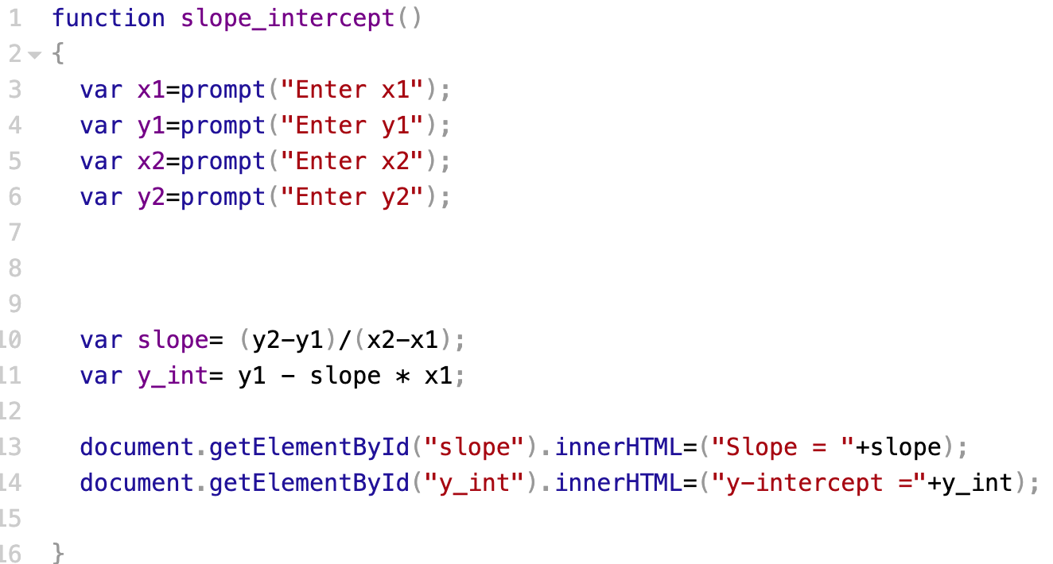
What are the "sections" or steps?

Slide 16
Your task - Coding your page
Open the CodePen Outline resource on our session's webpage
Complete the slope_intercept() function using your notes.
Run the program by clicking the button. Make sure it works.
Can you cause the program to “crash”? What type of input does this? How do you normally discuss this with your students?

Slide 17
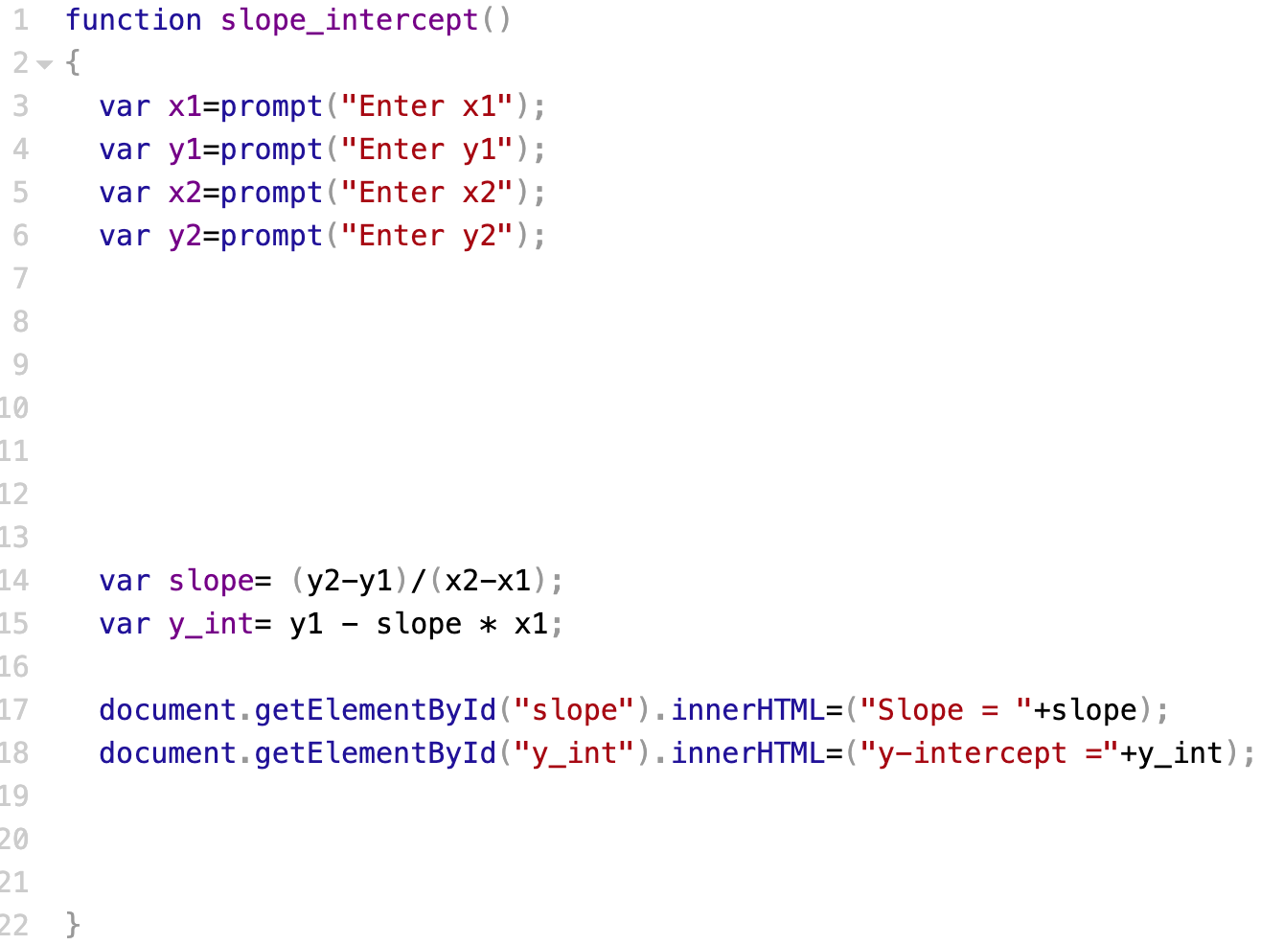
if … else

Slide 18
Another Function!
What other relational information can we calculate about two points in the coordinate plane?
Challenge: Create this function!
Use your slope_intercept() function as a guide.
Create a button in HTML that will run your new function.
You’ll also need a display area paragraph for your new output. This should go right below the ones for “slope” and “y-int”.

Slide 19
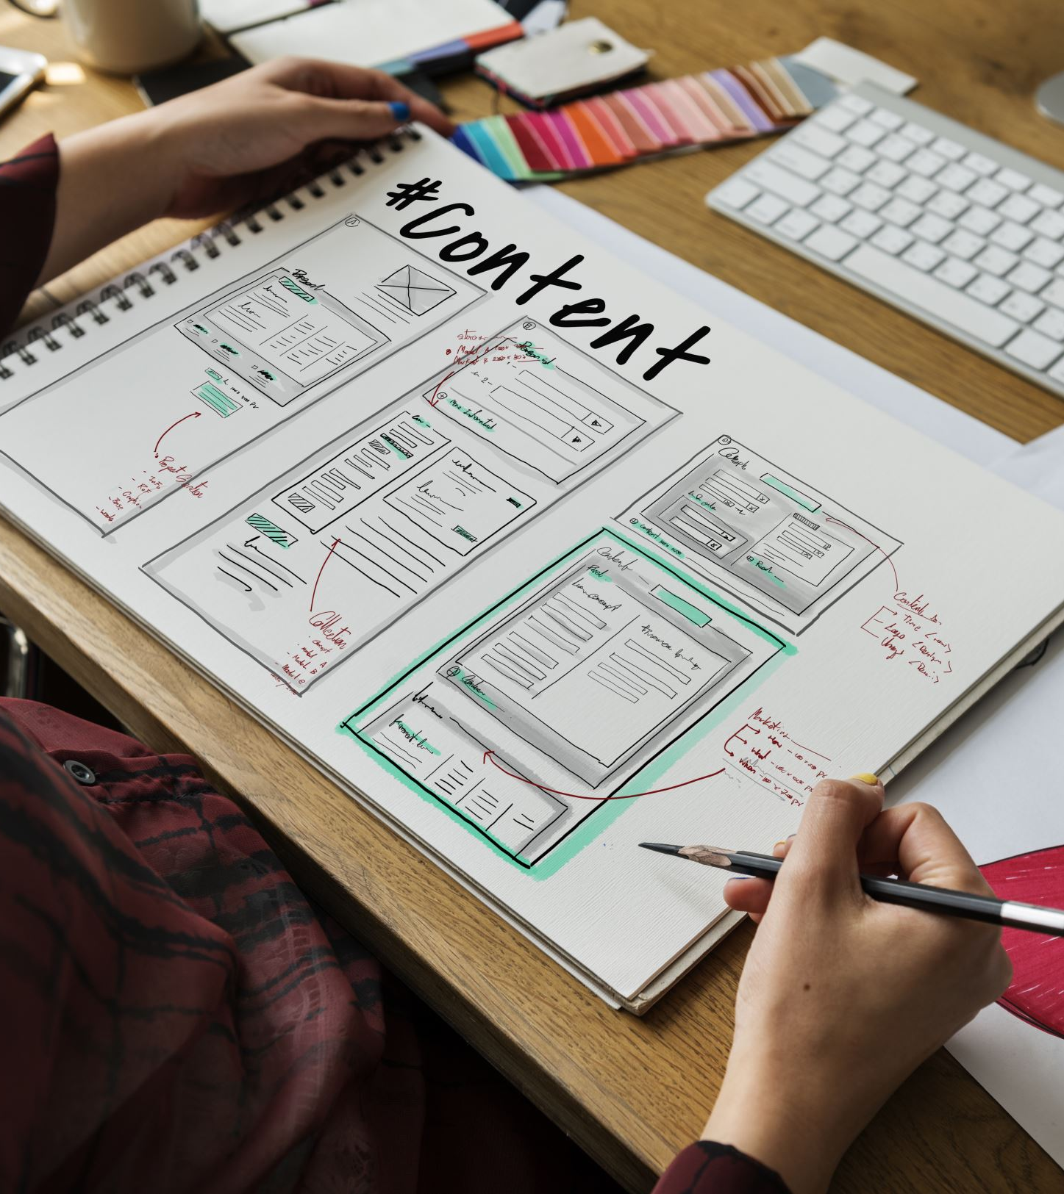
Design Time!
The middle window is CSS. This is where you style your page.
Explore, experiment, and customize your web app.
Use the resources on the session webpage to help.

Slide 20
Discussion
Using Notepad++ or any other text editor, students can copy the code from CodePen and have all the documents needed for a working webpage.
Thoughts, ideas, or questions?

Slide 21
References
Saeli, M., Perrenet, J., Jochems, W. M., & Zwaneveld, B. (2011). Teaching programming in Secondary school: A pedagogical content knowledge perspective. Informatics in education, 10(1), 73-88.
Salehi, S., Wang, K. D., Toorawa, R., & Wieman, C. (2020, February). Can majoring in computer science improve general problem-solving skills?. In Proceedings of the 51st ACM Technical Symposium on Computer Science Education (pp. 156-161).
Tu, J. J., & Johnson, J. R. (1990). Can computer programming improve problem-solving ability?. ACM SIGCSE Bulletin, 22(2), 30-33.
Werner, L., Denner, J., Campe, S., & Kawamoto, D. C. (2012, February). The fairy performance assessment: Measuring computational thinking in middle school. In Proceedings of the 43rd ACM technical symposium on Computer Science Education (pp. 215-220).

Slide 22
Email me with ideas or questions anytime!
Robert Richardson
rricha68@jhu.edu

